Slide 1
Computer Vision
with
Сonvolutional Neural Networks
Roman Naumov
MADS student at the University of Canterbury
Christchurch Data Science Meetup
New Zealand
09.04.2024
Notes:
Good evening everyone! My name is Roman Naumov, I am a Master’s student at the University of Canterbury. I'm studying Data Science with a focus on neural networks, and in particular I'm looking to work more with images and video. Thanks to Adam for inviting me to this meetup. Today I would like to talk a little about computer vision and give an introduction to convolutional neural networks.

Slide 2
Contents
Introduction into Computer Vision (CV)
Examples of CV tasks
History of Convolutional Neural Networks (CNN)
Examples of CNN tasks
The technical side of CNN
Real-world applications of CV
Notes:
Unlike previous meetings, today I will tell you the theoretical part of CNN and CV. Since there is a lot of information, it will be quite problematic to include both parts, practical and theoretical parts into one event. I divided the content of the presentation into the following logical parts. First, let's talk about what computer vision is, then I will briefly talk about the main stages of the invention of CNN. We will definitely discuss how CNNs are technically designed. And at the end, I will show you some examples of using CNN in real-life problems.

Slide 3
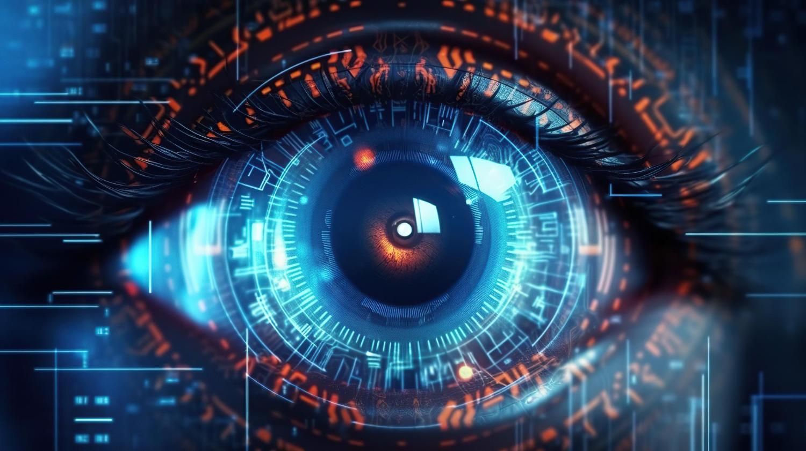
Computer Vision (CV)
Understand digital images or videos.
Automate tasks that the human visual system can perform.
Examples of CV tasks:
Acquiring
Sensors
Perception
Processing
Compression/Decompression
Denoising
Transformations
Analysis
Object recognition
Object tracking
Image segmentation
Pose estimation
Notes:
Computer vision tasks include methods for acquiring, processing, analyzing, and understanding digital images. Understanding in this context means transforming visual images into descriptions of the world that make sense to mental processes and can trigger appropriate actions. Computer vision is an interdisciplinary field that studies how computers can get high-level understanding of digital images or videos. In engineering terms, it aims to automate tasks that the human visual system can perform. Further, we will look at the 3 main components of Computer Vision - this is Image acquiring, processing and analysis.

Slide 4
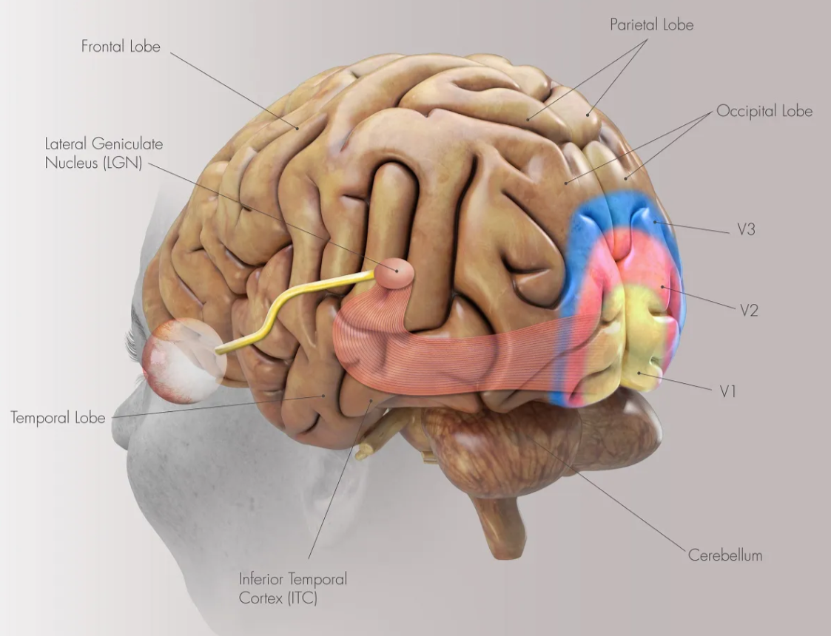
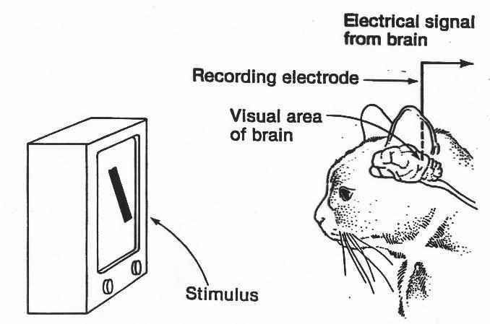
Human visual system
Hubel, D. H., & Wiesel, T. N. (1959). Receptive fields of single neurons in the cat’s striate cortex. The Journal of Physiology, 148(3), 574–591. https://doi.org/10.1113/jphysiol.1959.sp006308
Notes:
But now we’ll talk a little about how the human visual system works. This is important because people are trying to copy the laws of nature and reproduce it on computers.
“More than 50 percent of the cerebral cortex is responsible for processing visual information.” William J. Allyn, professor of medical optics, said this.
Our visual cortex is divided into several areas based on structural and functional classification. It is assumed that the complexity of visual processing increases for each region as visual information is transmitted. While simple cells are primarily located in V1 and respond to certain types of visual features, such as the orientation of edges and lines, complex cells in area V2 respond to differences in colors, complex patterns, and object orientation.
In the early 50s, two neuroscientists from Harvard Medical School, David Hubel and Thorsten Wiesel, conducted an experiment on the visual cortex of cats, the results of which earned them two Nobel Prizes. That experiment involves recording the activity of neurons in a cat's visual cortex as they move a bright line across the retina. The study showed that: (1) the neuron activated only the line that was in a specific location on the retina, (2) the neuron's activity varied depending on the orientation of the line, and (3) sometimes the neuron only activated when the line moved in a certain direction (different neurons respond to different angles). This discovery gave the way for modern computer vision and was implemented in a convolutional neural network model.

Slide 5
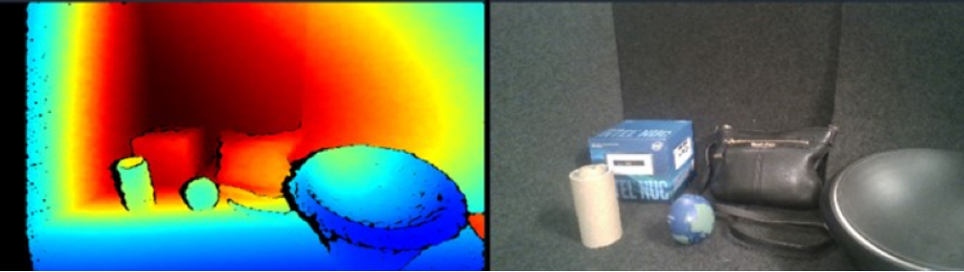
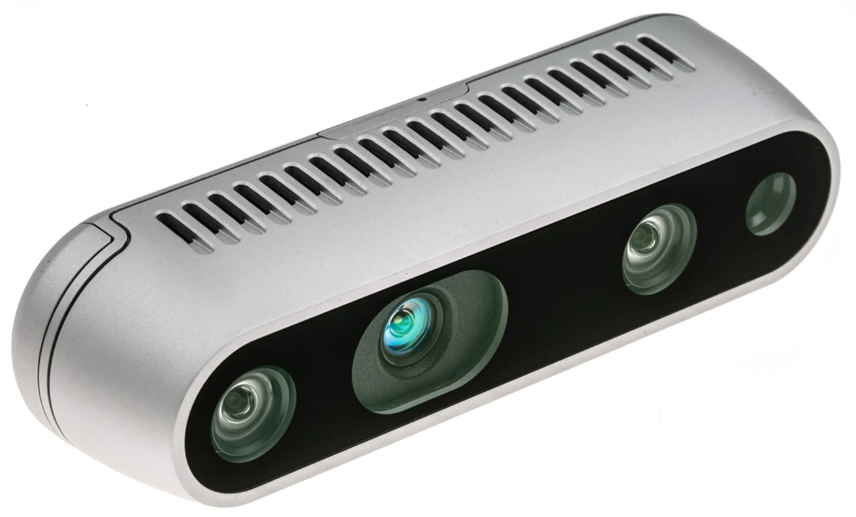
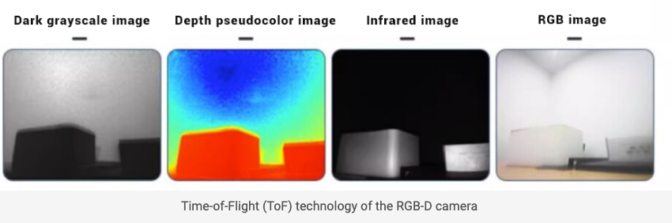
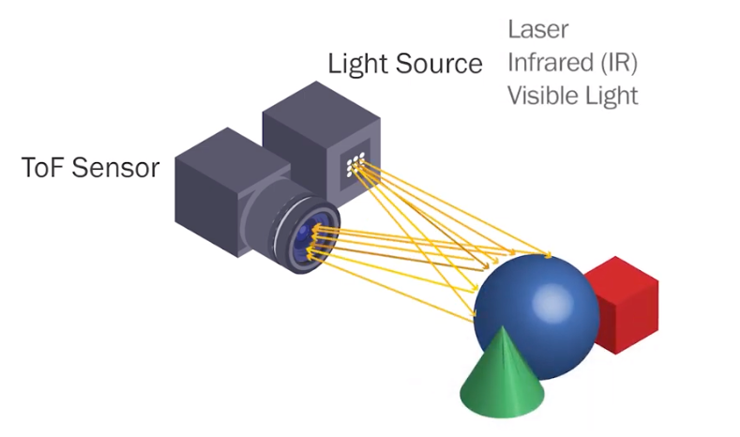
Image acquiring
Intel RealSense Depth 435
Time of Flight
Notes:
Returning back to main parts of CV, just see at Image acquiring. How to collect the visual information? Humans use their eyes to collect visual information. The machines use different types of cameras.
The slide shows two interesting examples of cameras. Intel RealSense D435 is a depth camera. Not only can it take a simple photo of what objects look like, but it can also determine how far objects are from the camera and thus achieve a 3D visual effect. The output of a depth camera is typically a depth map, where the value of each pixel represents the distance from that pixel to the camera. This depth information is very useful in many applications such as robot navigation, augmented reality, gesture recognition and more.
The other camera uses Time-of-Flight (TOF) camera technology. The basic principle of TOF is to use an infrared emitter to emit modulated light pulses. When light pulses are reflected from an object and returned to the receiver, the travel time of the light pulse is used to calculate the distance to the object. This modulation method places very high demands on the emitter and receiver - the light travels so quickly that extremely high precision is required to measure time. However, this principle is the basis of some other cameras.

Slide 6
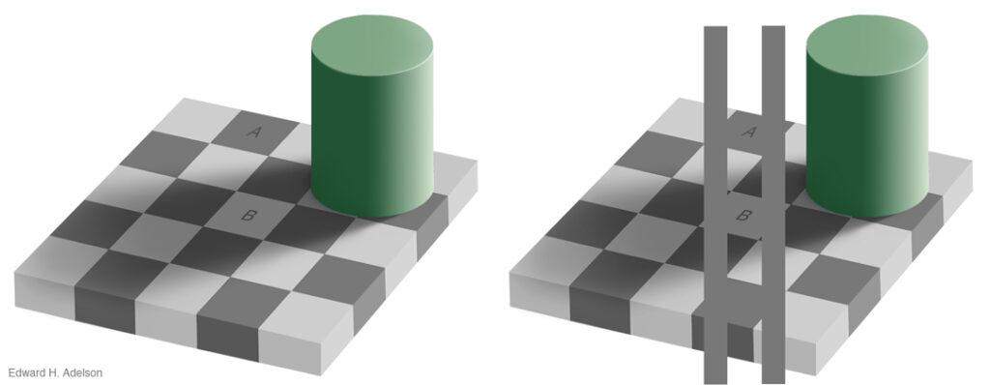
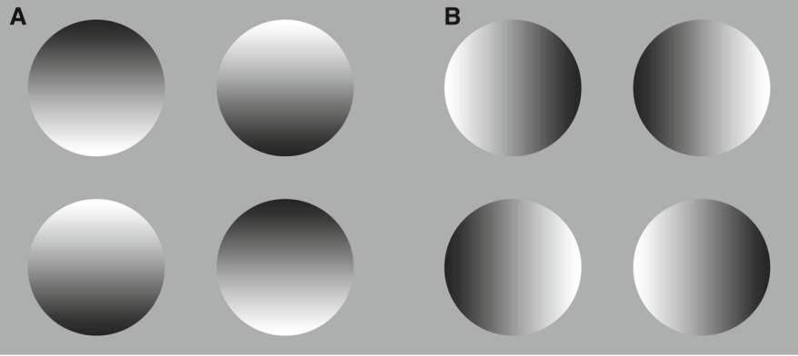
Image perception
The squares marked A and B are the same shade of gray.
Circular contours filled with A horizontally and B vertically aligned linear contrast gradients.
Notes:
The most important part is how to perceive the information. We know about visual illusions. The human visual system is inferential, meaning that it is based on our previous knowledge.
One of the task of the visual system is to define the color of objects in the surrounding world.
Let's look at two examples. In the first case, the task is to determine the gray shade of the A and B cells on the floor. A white surface in shadow may reflect less light than a black surface in full light. The visual system uses several techniques. The first trick is based on local contrast. In the picture, a light cell in the shadow is surrounded by darker cells, i.e. comparing the brightness of neighboring cells. The second trick is based on the fact that shadows often have soft edges, while borders of cells have sharp edges. The visual system tends to ignore gradual changes in light levels, so it can detect the color of surfaces without being fooled by shadows. Therefore, in fact, cell A and B have the same color.
Another example of an illusion is the second image with circles.
On the image, horizontally aligned linear contrast gradients are enclosed within circular outlines. However, we clearly see those circles with higher brightness at the top as convex, and those with lower brightness as concave. Thus, the visual system seems to “guess” the typical direction of illumination of the surface.

Slide 7
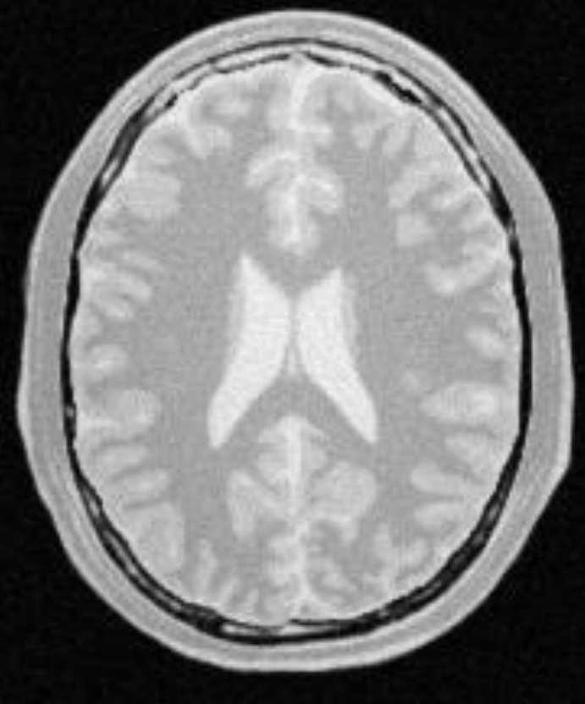
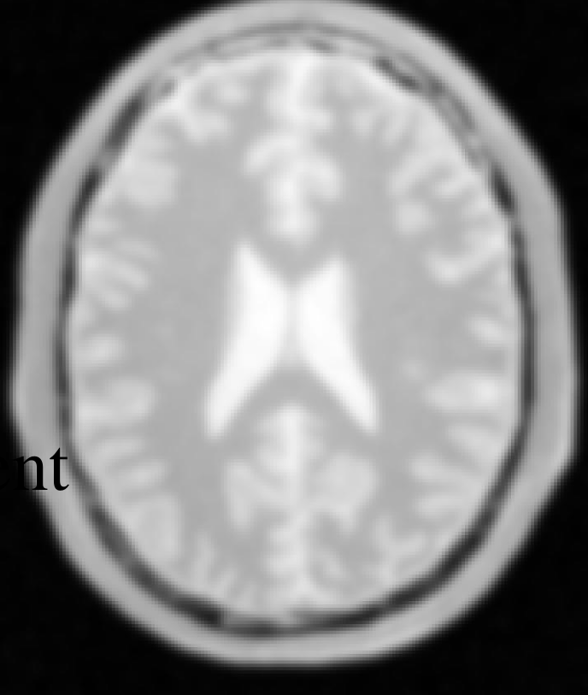
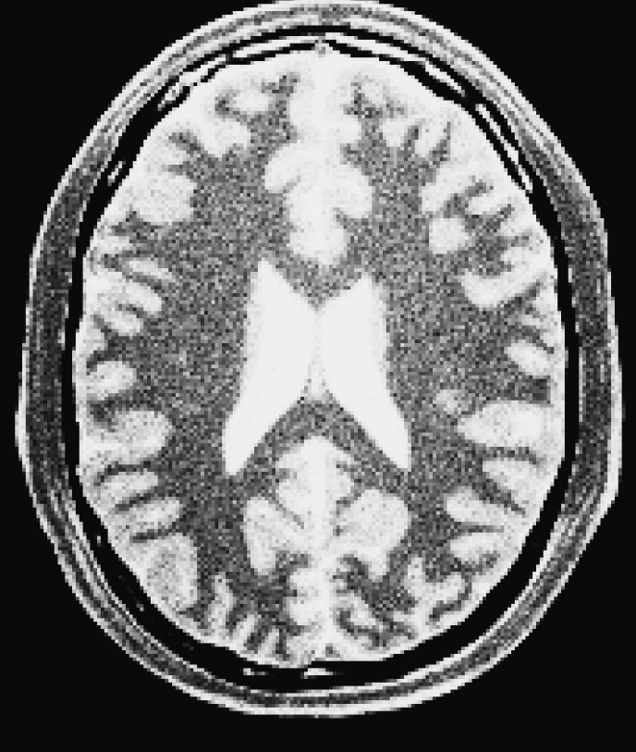
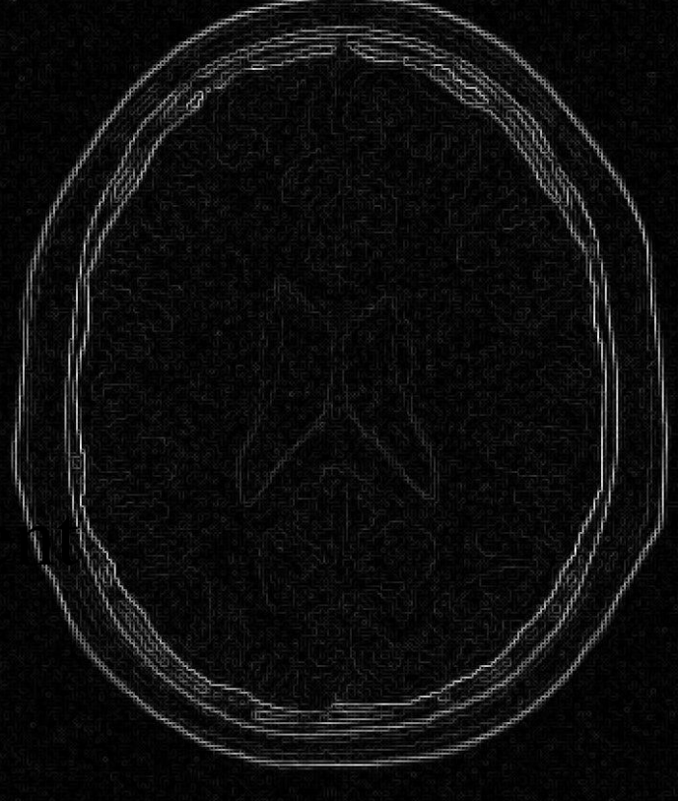
Image processing
Image compression
Noise reduction
Contrast enhancement
Edge extraction
Segmentation, Thresholding, Morphology, Image restoration, etc.
Notes:
As I mentioned above in the case of the human visual system, after receiving an image, this information needs to be preprocessed, simple elements such as boundaries, edges, curved or straight lines must be identified, noise removed, etc. We do the same in the case of computer vision. The slide shows some examples of image preprocessing.

Slide 8
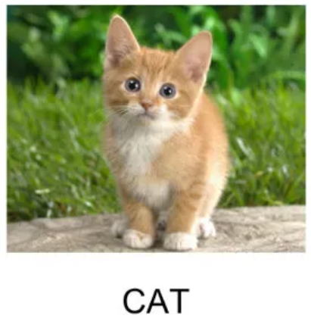
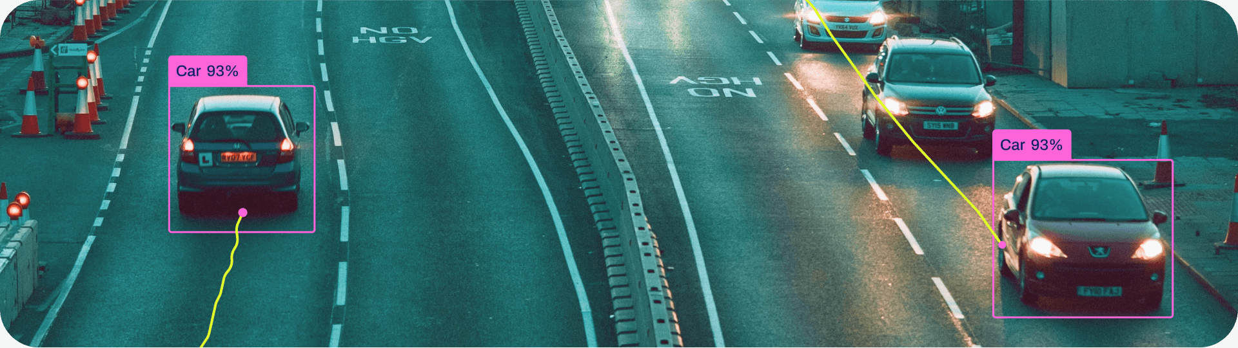
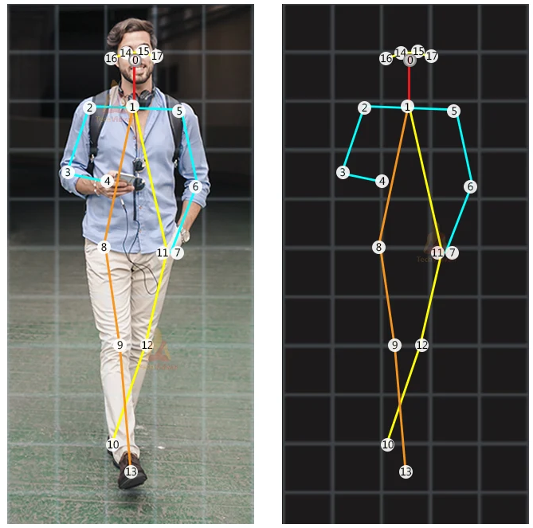
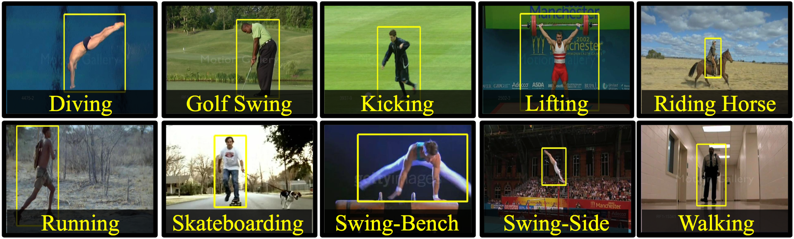
Image analysis
Object tracking
Image
classification
Action recognition
Pose
estimation
Notes:
The most interesting part is analyzing and understanding the images. A human does this automatically, based on the experience and knowledge that he has accumulated during his life. In the case of computer vision, we need to develop algorithms that can understand images. The slide shows some examples of image analysis such as image classification, object detection and tracking to track that object in a video, action recognition to understand what a person is doing, and pose estimation by detecting the movements of body parts.

Slide 9
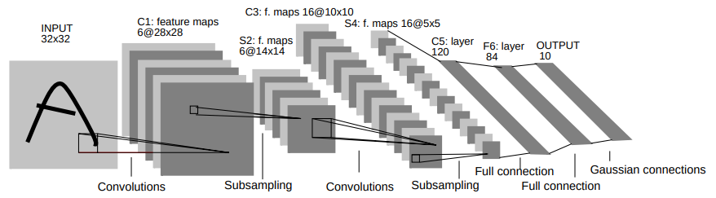
Convolutional Neural Networks (CNN)
The term “convolutional neural networks” appeared in connection with the development of the LeNet neural network by a team led by Yann LeCun (LeCun, Y., Bottou, L., Bengio, Y., & Ha, P. (1998). Gradient-Based Learning Applied to Document Recognition.)
The network architecture was developed between 1989 and 1998 for the task of handwritten digit recognition.
Notes:
One of the algorithms that allows you to analyze images is Convolutional Neural Networks. The name convolutional neural networks actually originated with the design of the LeNet by Yann LeCun and team. It was mainly developed between 1989 and 1998 for the handwritten digit recognition task. The article you can find in the internet, it’s free access for all. The overall architecture consists of 5 layers and have 60 thouthands parameters. About the structure of this types of neural networks we will talk a little later, when we will discuss about technical side of CNNs.

Slide 10
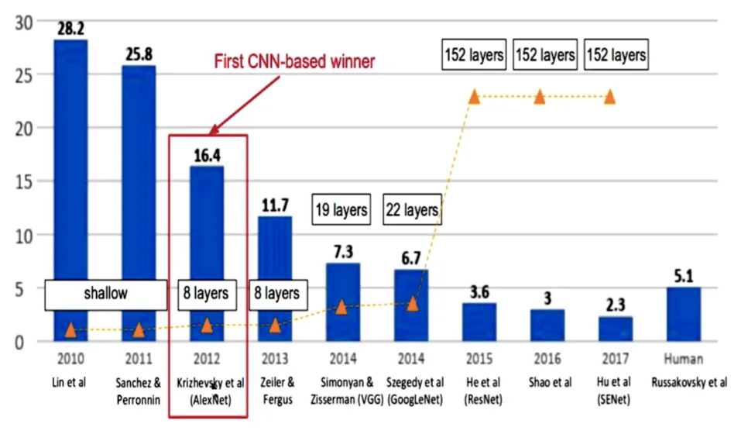
History of CNNs
Notes:
The modern history of CNN begins with the victory in the ImageNet-2012 competition, the task of which is image classification.
The AlexNet model, based on the CNN architecture, became the winner of the ImageNet competition in 2012. Subsequently, in the remaining years, only CNN models, such as VGG, GoogleLeNet, won, each time reducing the classification error. In 2015, the ResNet model won with a classification error of 3.6%, which is lower than the human classification error of 5.1%. In fact, since 2015, CNN algorithms have surpassed humans in classification quality.

Slide 11
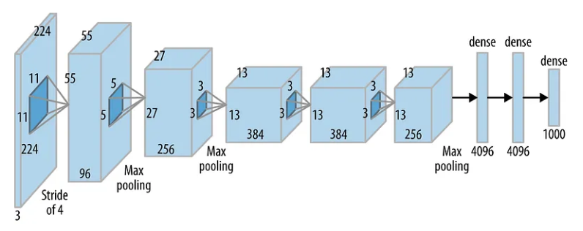
AlexNet, 2012
AlexNet was born out of the need to improve the results of the ImageNet challenge.
Accuracy of 84.7% - winner of ILSVRC in 2012.
5 Convolutional (CONV) layers and 3 Fully Connected (FC) layers. Activation function - Rectified Linear Unit (ReLU).
The paper - Krizhevsky, A., Sutskever, I., & Hinton, G. E. (2012). ImageNet Classification with Deep Convolutional Neural Networks. Advances in Neural Information Processing Systems, 25.
Notes:
AlexNet was one of the first deep convolutional networks, achieving a significant accuracy of 84.7% on the ImageNet challenge in 2012.
The network consists of 5 convolutional (CONV) layers and 3 fully connected (FC) layers. The activation function is a rectified linear unit (ReLU), which was new at that time. There are a total of 62 million trainable variables in the network. The input to the network is 224x224 pixel color images, and the output is a 1000x1 probability vector corresponding to each class.

Slide 12
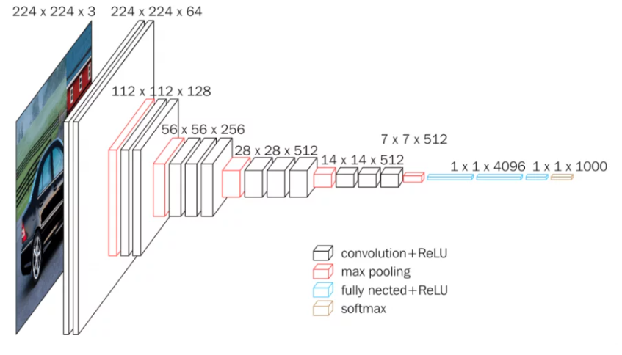
VGG-16, 2014
Accuracy of 92.7%.
Fixed-size smaller filters.
13 Convolutional layers and 3 Fully Connected (FC) layers.
The paper - Simonyan, K., & Zisserman, A. (2014). Very Deep Convolutional Networks for Large-Scale Image Recognition.
Notes:
In 2014, the VGG16 model was introduced which classifying images with an accuracy of 92.7%.
Why is this model so important? VGGNet was based on the idea of reducing the number of trainable parameters in the convolution layers, thereby reducing the training time and also reducing the tendency to overfit the network. This was achieved by using a small size of kernels, compared to the AlexNet model.

Slide 13
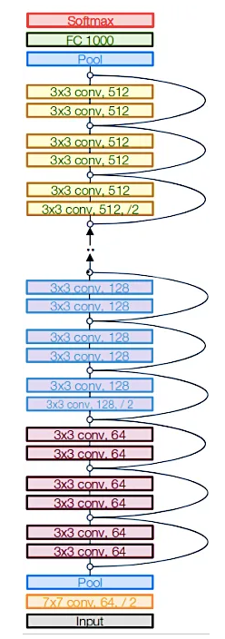
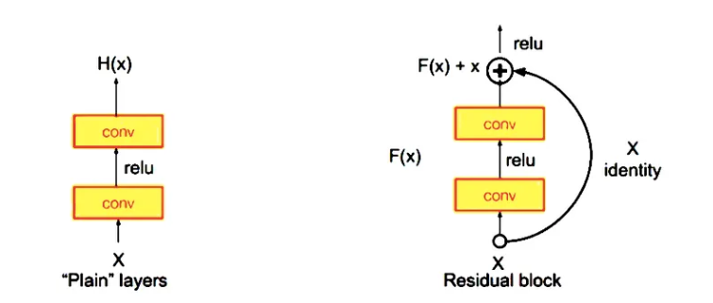
ResNet-152, 2015
Accuracy of 96.4% - winner of ILSVRC in 2015.
ResNet architecture makes use of shortcut connections to solve the vanishing gradient problem.
152 layers.
The paper - He, K., Zhang, X., Ren, S., & Sun, J. (2015). Deep Residual Learning for Image Recognition.
Notes:
It is interesting to note that every year the model with more layers in the neural network won the competition than the previous year. Does this mean that by adding more layers we will get better classification accuracy? Experiments have shown that accuracy decreases as more layers are added to the network. It turned out that the problem arose due to a vanishing gradient. The deeper we make the CNN, the smaller the derivative becomes when the error propagates back to the initial layers. This leads to the fact that the weights in the first layers of the neural network do not change at all.
To solve the problem of vanishing gradient, the ResNet architecture was invented, which uses short connections. The basic building block of ResNet is the residual block, which is repeated throughout the network. As a result, such a neural network took first place in 2015 and showed better results than human-assisted classification.

Slide 14
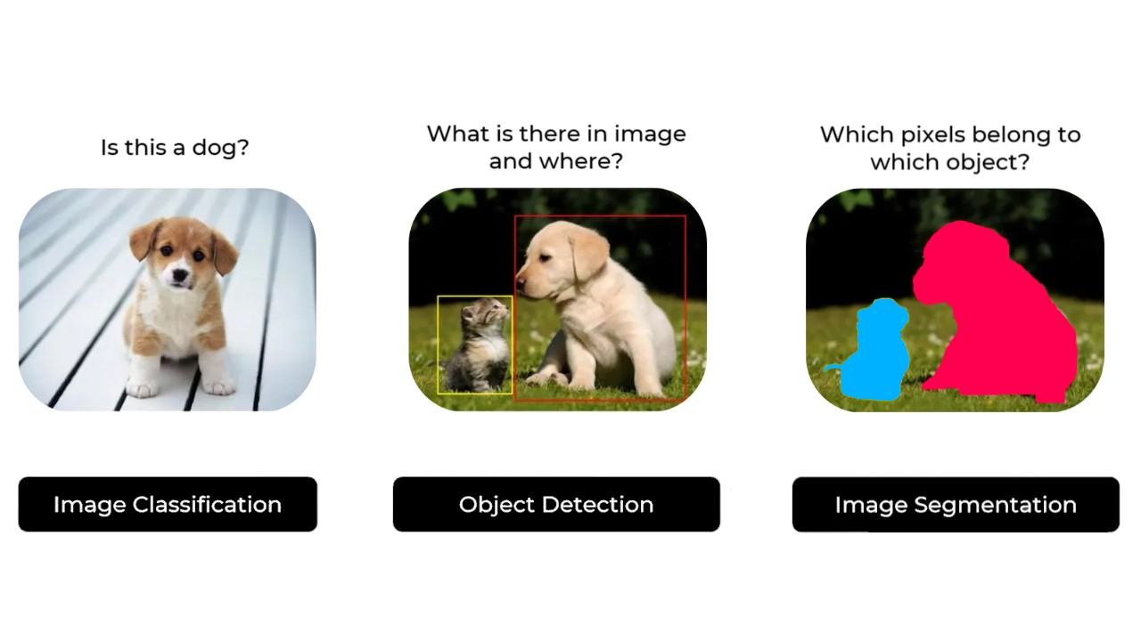
Examples of CNN tasks
Notes:
Let's see what basic problems CNN can solve. These are the classical image classification problems, the object identification problem and the segmentation problem.
It is worth noting that all these tasks belong to the class of supervised learning, i.e. in the training dataset we must know exactly the number of classes, all images must be labeled. If the object is not in the classes, then it will not be found when the algorithm runs.
The classic problem of image classification is to answer the question of what is shown in the picture. As part of the image object identification task, we must identify all the objects from the classes available to us and determine where they are located using a bounding box. The purpose of segmentation is to ensure that each pixel in an image is assigned an object present in the image and a class number.

Slide 15
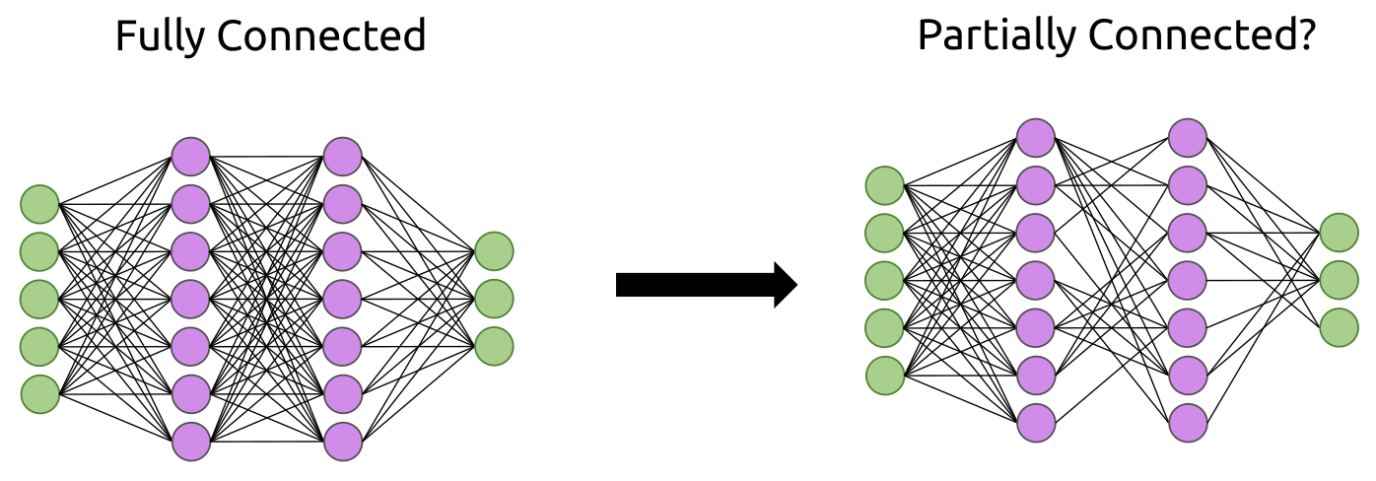

Why not use fully connected neural networks?
Disadvantages of fully connected NN when working with images:
Translational Invariance
Spatial dependencies are broken
Too many connections

Slide 16
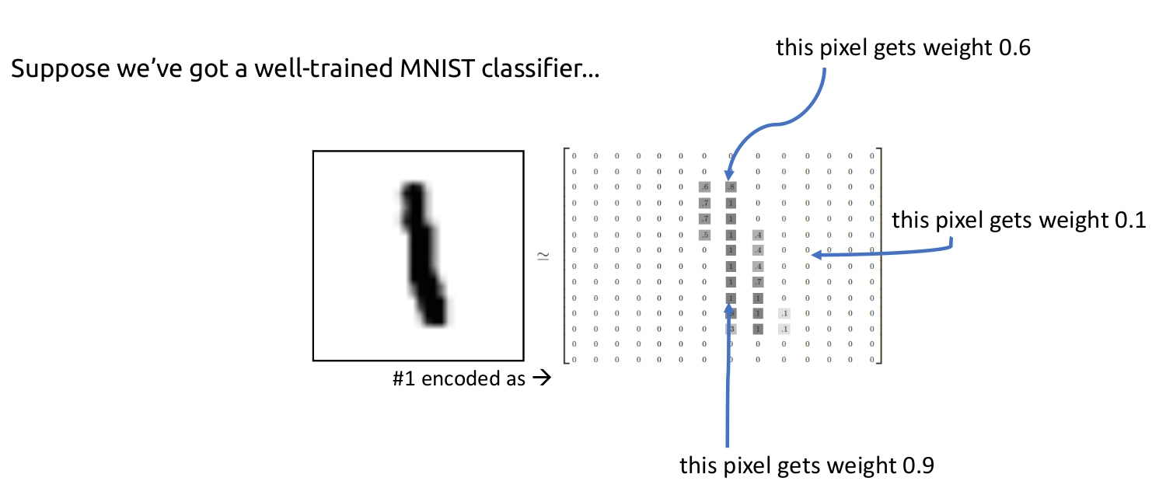
Well-trained classifier
Notes:
Suppose we’ve got a well-trained MNIST classifier.

Slide 17
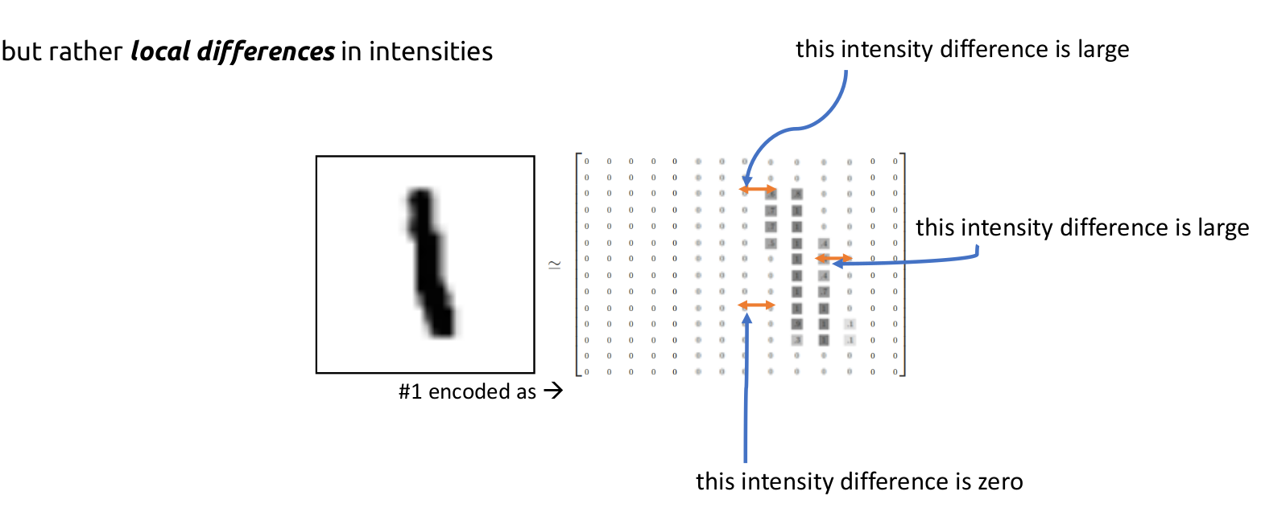
This is not a problem for the human visual system.
If we shift the digit to the right, then a different set of weights becomes relevant a network might have trouble classifying this as a 1.
Notes:
If we shift the digit to the right, then a different set of weights becomes relevant a network might have trouble classifying this as a 1.
This would not be a problem for the human visual system.
Our eyes don’t look at absolute intensity values, but rather local differences in intensities.

Slide 18
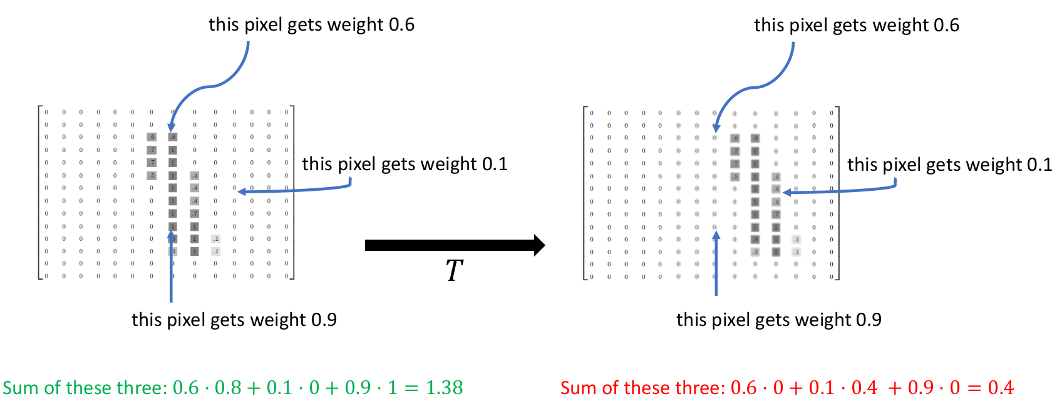
Translational Invariance
Notes:
Fully Connected Nets are not Translationally Invariant.

Slide 19
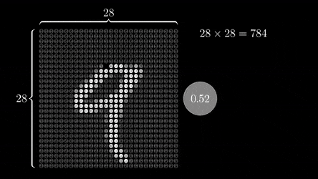
Spatial dependencies are broken
Pixels aren’t independent, nearby pixels are correlated and areas in the image
have local connectivity.
When we convert a matrix to a vector,
we break pixel dependencies.
Notes:
Look at the patterns of the image

Slide 20
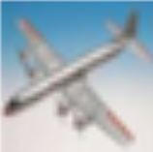

Too many connections
There are two problems:
Computing resources.
The fully-connected (FC) neural network can memorize the image.
28x28x3 = 2352 inputs
1024x1024x3 = 3,145,728 inputs
28
1024
28
1024

Slide 21
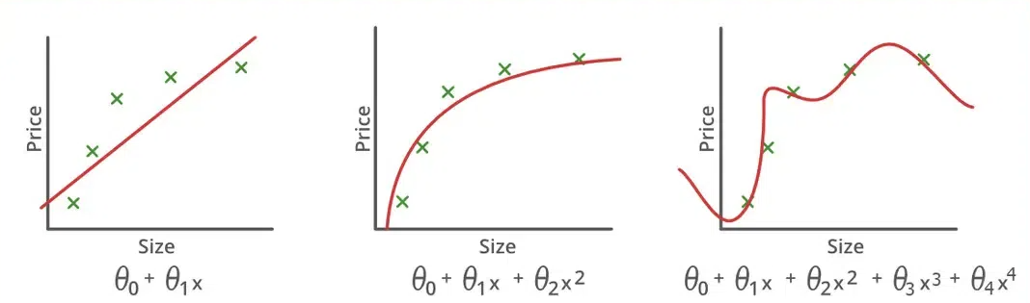
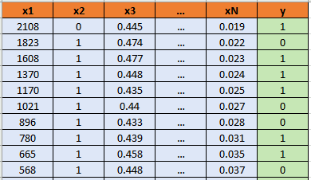
The FC neural network can memorize the image
Underfitting Goodfitting Overfitting
Feature Engineering
stepAIC
CNN

Slide 22
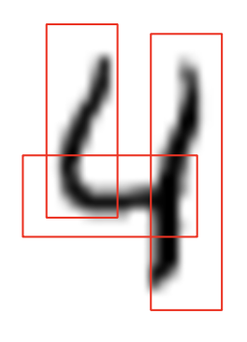
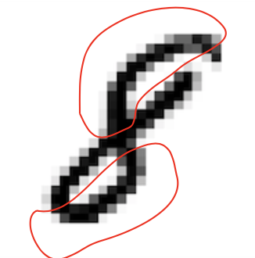
What features are there in the image?
What is the difference between a four and an eight?
The number 4 has horizontal and vertical lines, while the number 8 has curved lines.
Can we build networks that are:
Translationally invariant
Don't overfit
Can extract features from images?

Slide 23
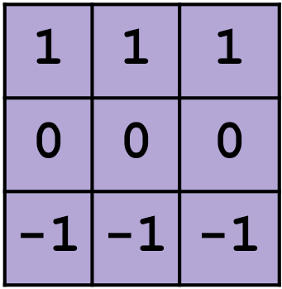
Main building blocks for convolution
Convolution is an operation that takes two inputs:
An image
A filter (also called a kernel)

Slide 24
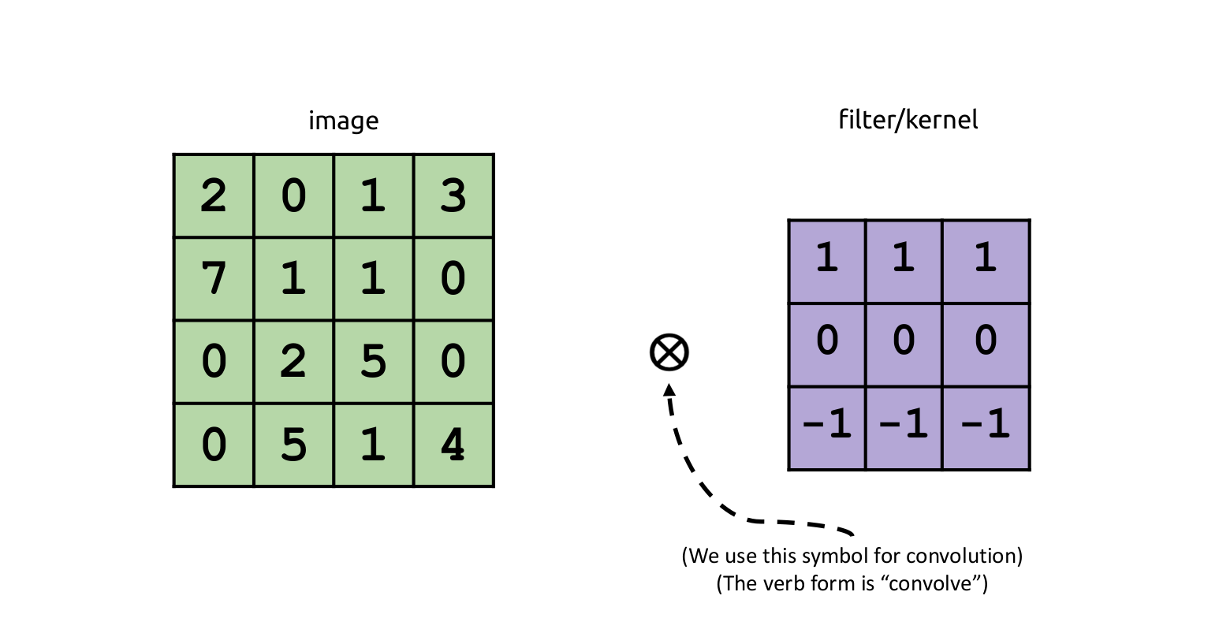
How does convolution work?

Slide 25
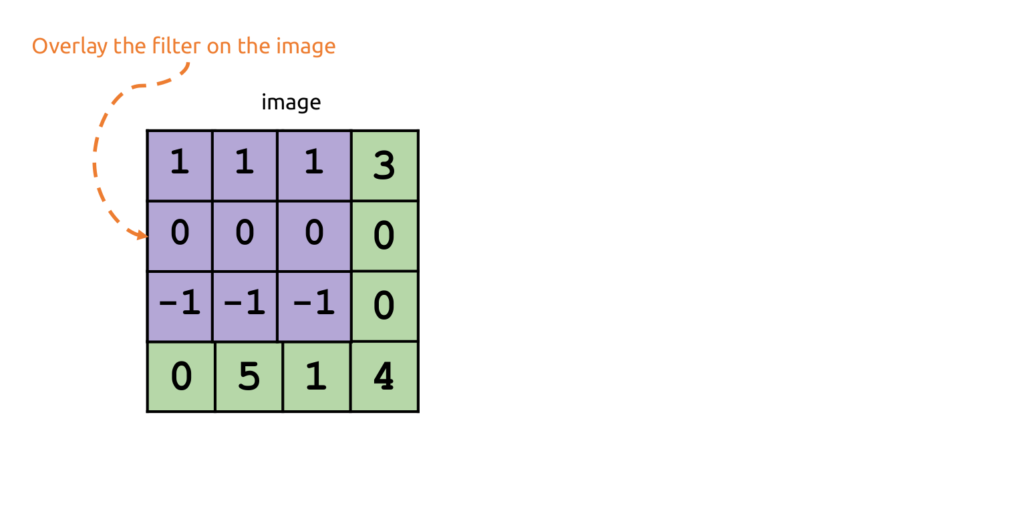
How does convolution work?

Slide 26
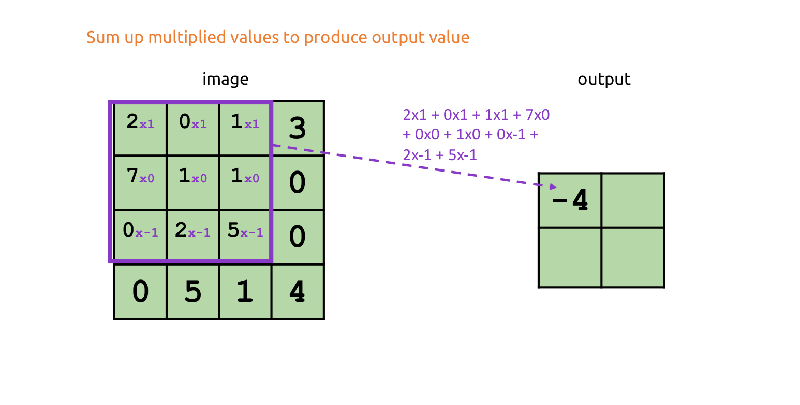
How does convolution work?

Slide 27
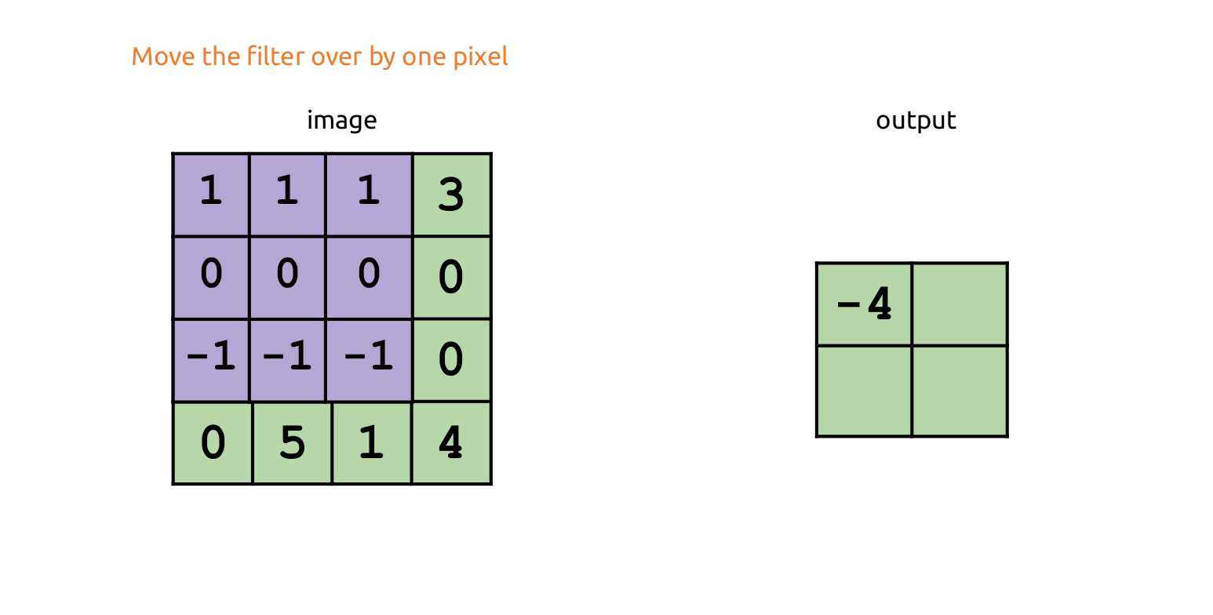
How does convolution work?

Slide 28
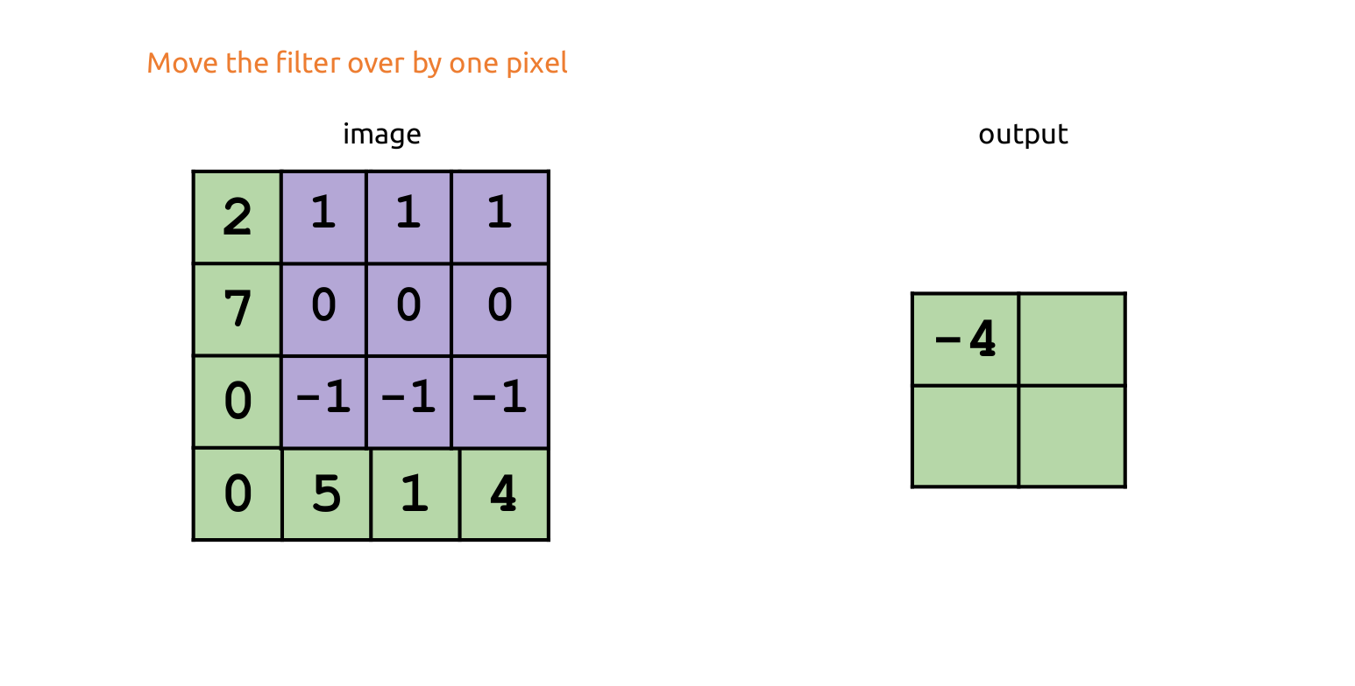
How does convolution work?

Slide 29
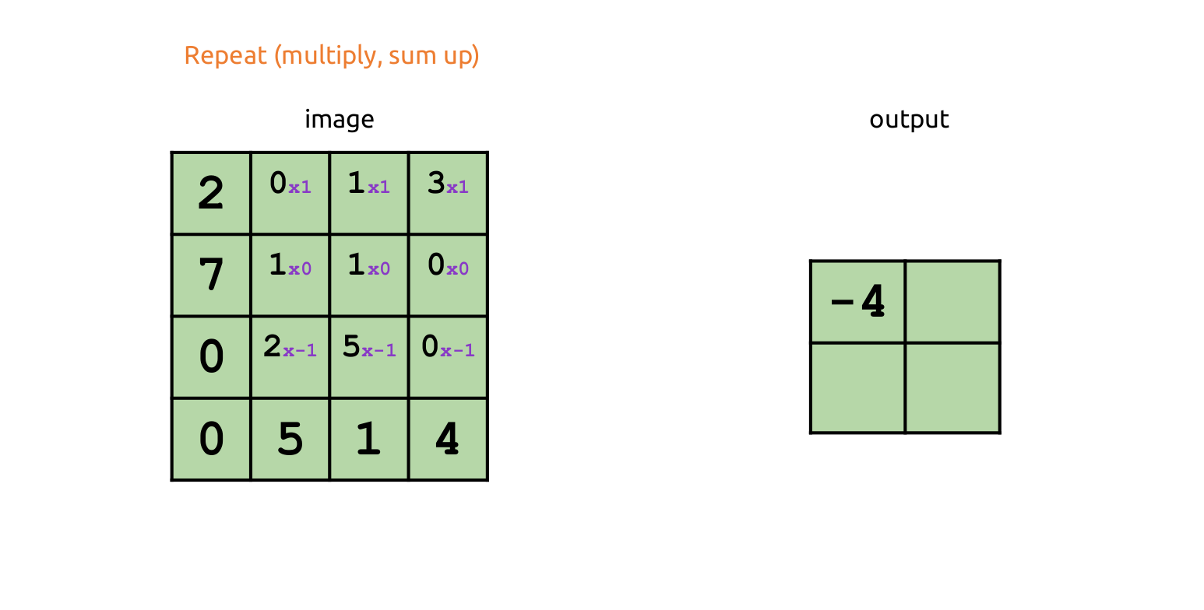
How does convolution work?

Slide 30
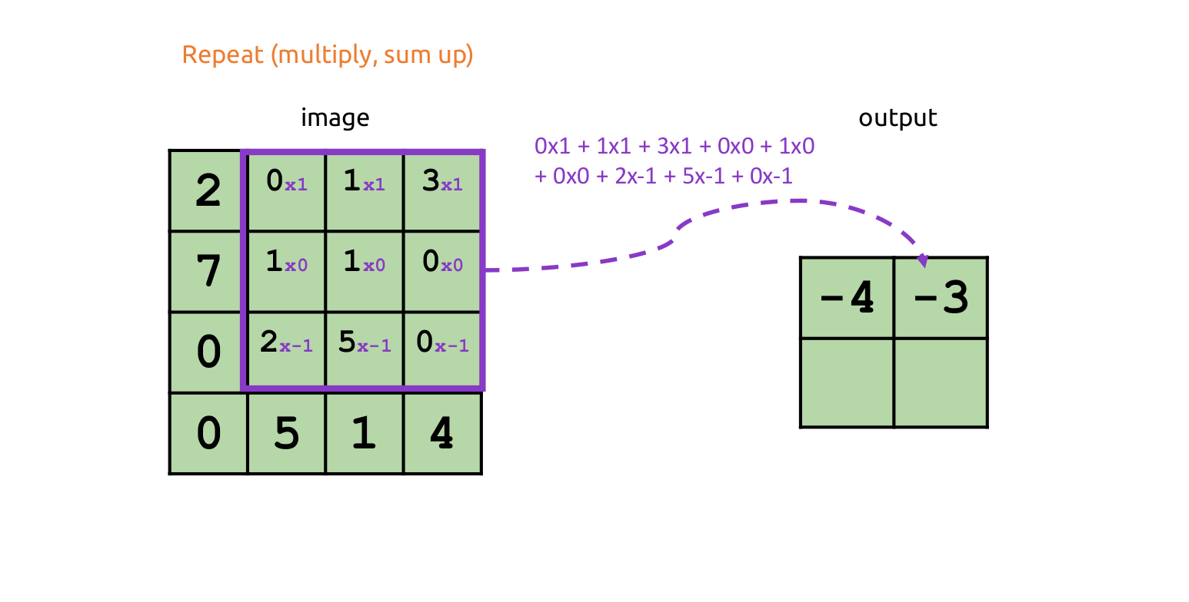
How does convolution work?

Slide 31
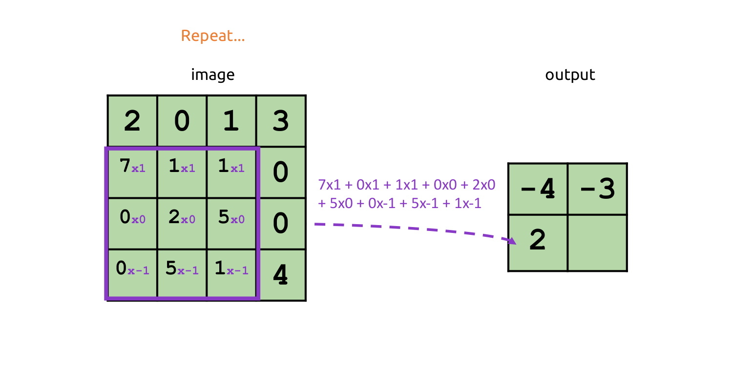
How does convolution work?

Slide 32
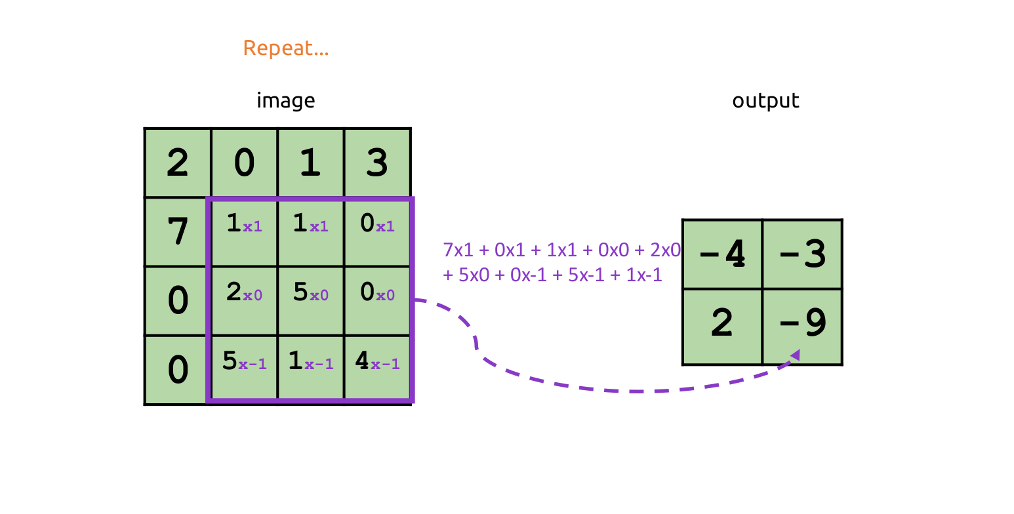
How does convolution work?

Slide 33
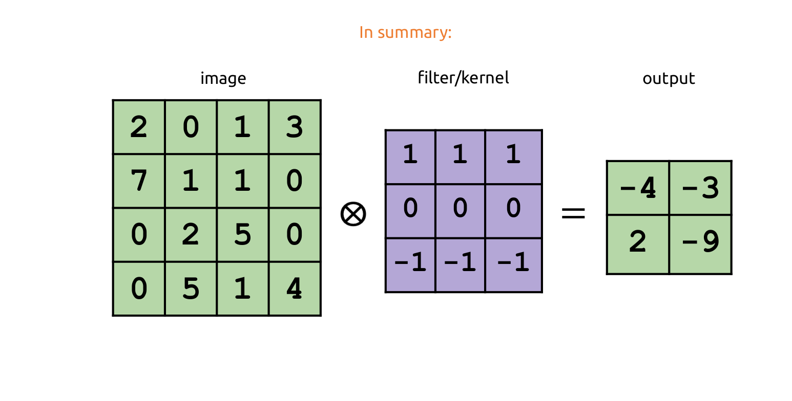
How does convolution work?

Slide 34
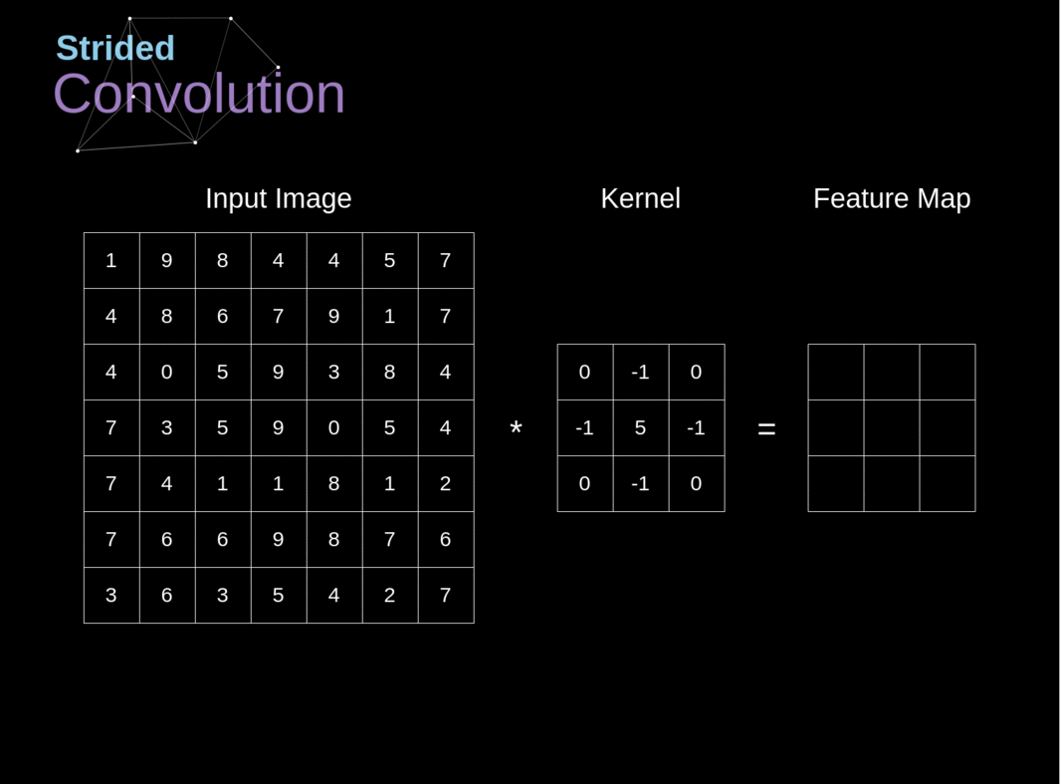
How does convolution work?

Slide 35
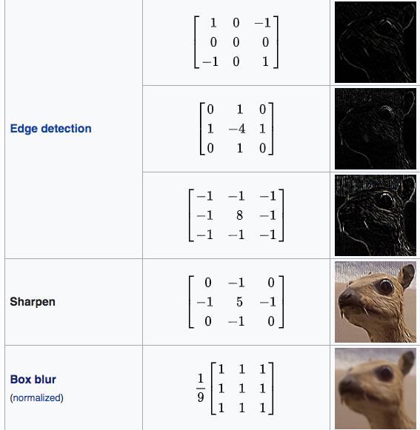
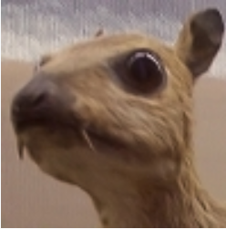

Different kernel can cause a wide range of effects

Slide 36

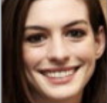
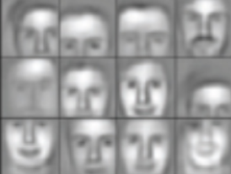


CNN feature maps
1st CONV
layer
2nd CONV
layer
3rd CONV
layer
4th CONV
layer
Fully-connected layers
Low-level patterns
Mid-level patterns
High-level patterns

Slide 37

How to learn CNN?
Input image
Filter/Kernel
(learnable parameter)
Feature map
Notes:
The neural network itself learns to understand what patterns in the image it is important for it to be able to find.

Slide 38


Input, Filter, Stride, Padding
Input = 5x5
Output = 5x5
Input = 5x5
Output = 2x2
Stride = 1, Padding = 1
Stride = 2, Padding = 0
Notes:
Use this to (controllably) decrease image resolution or save the same output as an input!

Slide 39


Pooling
Input image Kernel Feature Map Pooling
12 20 30 0
8 12 2 0
34 70 37 4
112 100 25 12
Image -> conv -> act -> pool -> conv ...

Slide 40

Max Pooling
Keeps track of regions with highest activations, indicating object presence.
Controllable way to decrease resolution.
Intended to give invariance to small translations.
Original Image Convolution Output After Pooling

Slide 41

Typical CNN Architecture

Slide 42

AlexNet, VGG, ResNet

Slide 43


Real-world applications of CV (segmentation)
Medical image segmentation for tumor detection.
Segmentation of street infrastructure and facilities. Used in the development of self-driving cars.

Slide 44

Real-world applications of CV (self-driving cars)
detection
classification
segmentation
search by images
car position assessment

Slide 45


Real-world applications of CV (OCR)
Notes:
automatic translation
improving the quality of document photos
scan of receipts/business cards/etc
vehicle license plate recognition

Slide 46

Real-world applications of CV (vehicle counting)

Slide 47

Real-world applications of CV (pose estimation)

Slide 48


Real-world applications of CV (hand gesture recognition)

Slide 49


Real-world applications of CV (CNN + others)
Atari games - CNN + RL
Action human recognition - CNN + LSTM

Slide 50
Acknowledgments
Adam Green, Host of Christchurch Data Science Meetup, Christchurch
https://www.linkedin.com/in/adgefficiency/
Tatiana Gaintseva, Lecture at the Deep Learning School, Moscow
https://www.linkedin.com/in/tgaintseva/
James Atlas, Senior Lecturer at the University of Canterbury, Christchurch
https://www.linkedin.com/in/james-atlas-a13b9745/
Daniel Ritchie, Assistant Professor at Brown University, USA https://dritchie.github.io/
Richard Green, Professor at the University of Canterbury, Christchurch
https://www.linkedin.com/in/richard-green-aa7a36223/

